Slide 1
Paper Nine: English Phonetics and Linguistics
Difference between R. P. and General Indian English
by
Dr. Prithiviraj Singh Chauhan

Slide 2
What is R. P. ( Received Pronunciation) in English?
“RP is a way of pronouncing British English that is often considered to be the standard accent. Pronunciations in this dictionary are given in RP. RP is an abbreviation for 'Received Pronunciation”. ( Collin Dictionary)
English is spoken with different pronunciation in world.
But English spoken in Britain is regarded as authentic English or standard English
IPA, International Phonetic Alphabets has created received pronunciation R.P or B.E. English

Slide 3
Continued..
British phonetician Daniel Jones in his English Pronunciation Dictionary (1917) used the term ‘public school pronunciation’ and subsequently used the term Received Pronunciation in second edition of the dictionary in 1926.
There is considerable debate over the suitability of R.P. to all the learners.
Some scholar even used BBC English in place of R.P.
R.P. can be understood as accepted or approved pronunciation.

Slide 4
What is GEI (General Indian English) or Indian English
English is official recognized language in India.
In his book The English Language (1990) David Crystal observed, "British English is now, numerically speaking, a minority dialect, compared with American, or even Indian, English.“ (Wikipedia)
English is learned as secondary language in India
Before learning English, we learn our mother tongue and form strong linguistics habits related to mother tongue
The phonological system of mother tongue will have an influence on the phonology of their English

Slide 5
.
India is a multilingual country and different variety of languages spoken across the region.
These variety of languages have their influence on English
For examples:
A Tamilian often pronounce egg as /jeg/,
A Telgu speaker pronounce uncle /ˈʌŋkul/ in place of /ˈʌŋk(ə)l/
A Bihari pronounces school as /isku:l/ and stamp as /istæmp/
Many Bengalis and Oriyas pronounce sip and ship all alike.
Many Bengalis pronounce sit and seat alike.
Malyalees pronounce the /p/ in temple as /b/, the /t/ in canteen as /d/ and the /k/ in uncle as (g)

Slide 6
.
change in different sounds poses the problem of unintelligibility for speaker the speaker of different languages.
If we allow effect of mother tongue to override the R.P it will create many Englishes in India.
If we put the common phonological features of several varieties of Indian English together and remove from each variety certain gross regional features, a variety of English will emerge which can be called General Indian English.
By General Indian English is meant a certain variety of English spoken by educated Indians.

Slide 7
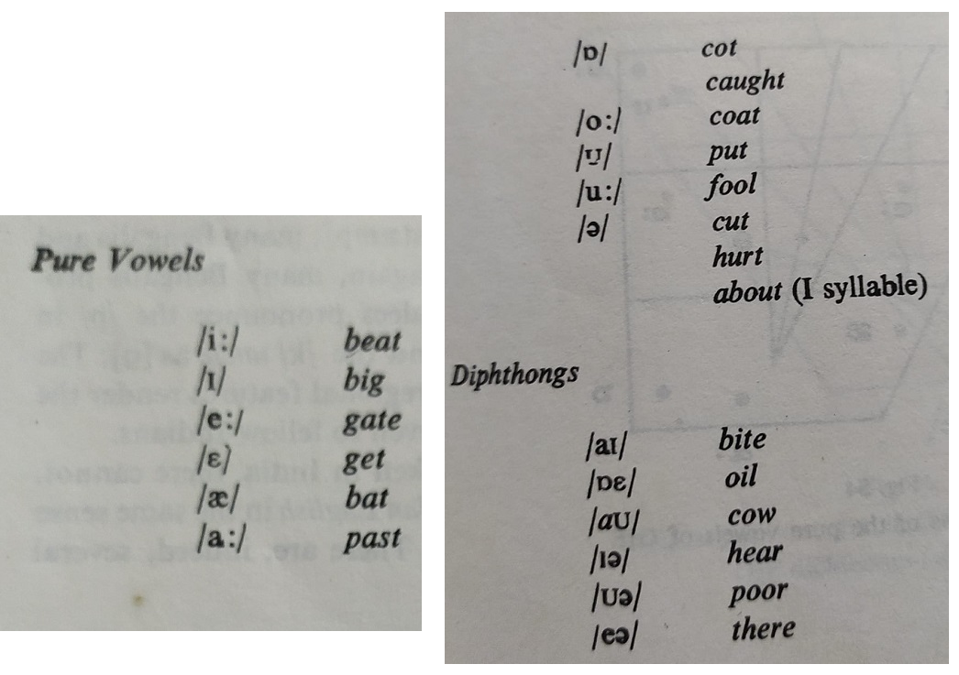
The vowel system of General Indian English (GIE)
In contrast to R.P. it consist of eleven (11) pure vowel and six (6) diphthongs

Slide 8
Position of vowel in R.P. & GEI
R.P. Vowel Position
GIE Vowel Position

Slide 9
Position of vowel in R.P. & GEI
R.P.
GEI

Slide 10
Position of vowel in R.P. & GEI
R.P.
GEI

Slide 11
Position of vowel in R.P. & GEI
R.P.
GEI

Slide 12
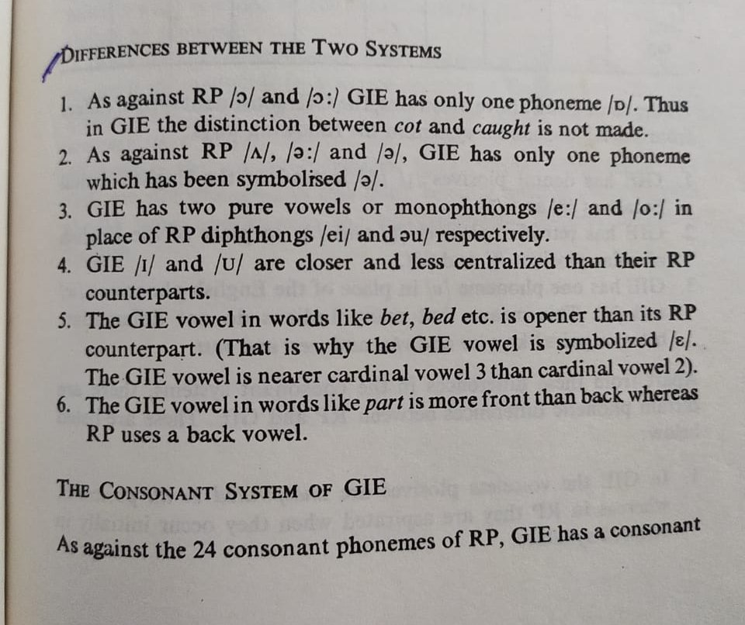

Slide 13
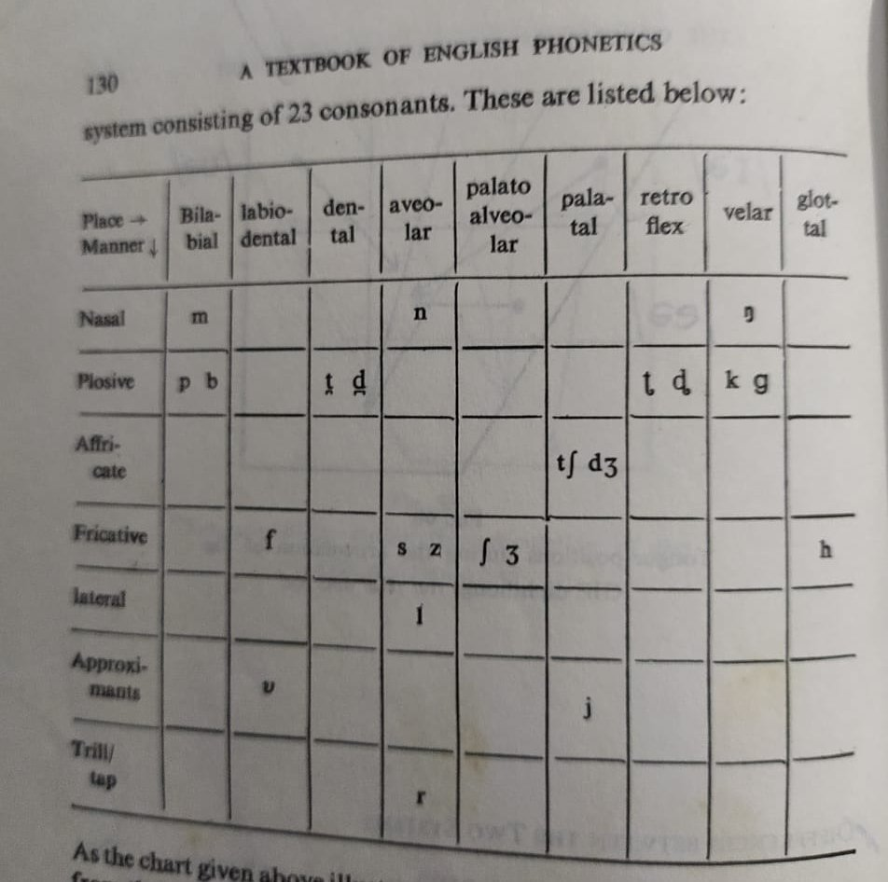

Slide 14
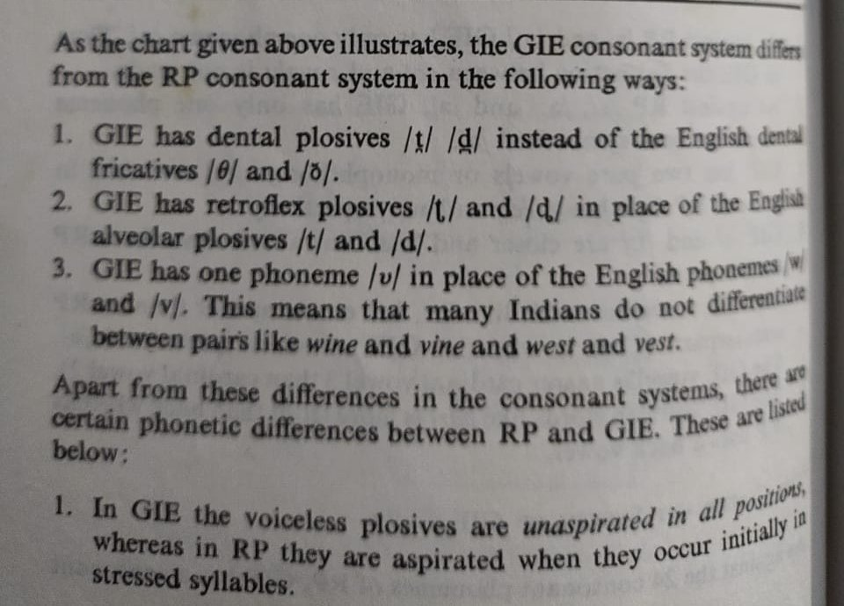

Slide 15
Reference
Collin Dictionary. https://www.collinsdictionary.com/dictionary/english/rp. retrieved on 28/08/2020
https://en.wikipedia.org/wiki/Indian_English Retrieved on 28/08/2020
Balasubramanian, T. (2002) A Textbook of English Phonetics for Indian Students. Delhi: Macmillan India Ltd. rpt.
All the images used in slide has been taken from A Textbook of English Phonetics for Indian Students with due credit.

